Slide 1



PAGE 1
DEPI PROJECT
Red Teaming

Slide 2



PAGE 2
What is Red Teaming?
·Red Teaming is the practice of simulating real-world cyberattacks to test the effectiveness of an organization’s defenses.
·A Red Team acts like a real adversary, attempting to exploit vulnerabilities across systems, people, and processes.

Slide 3
PAGE 3
RED TEAM
Long term and goal oriented
Test detection and response
Often stealthy and unannounced
RED Team VS.
Pen testing
PEN TESTING
Short term and scoped
Find vulnerabilities
Often announced

Slide 4
PAGE 4
Red Teaming phases
1. Reconnaissance – Information gathering.
2. Vulnerability Analysis – Identifying weak points.
3. Exploitation – Gaining unauthorized access.
4. Lateral Movement – Expanding access within the network.
5. Objective Completion – Achieving the mission
(e.g., data exfiltration).
6. Reporting – Documenting findings and recommendations.

Slide 5
PAGE 5
Simulated Red Team Engagement – Company X
Our Red Team was hired by Company X, a mid-sized tech company concerned about the security of a legacy web server that holds sensitive internal documentation and user data.
Target:
⟶ Hostname: mrrobot.companyx.internal
⟶ IP Address: 192.168.1.32 (we will know it in phase of reconnaissance)
⟶ Environment: Legacy Linux server hosting an old CMS platform.
⟶ Objective: Assess how an attacker might gain unauthorized access and retrieve confidential files.

Slide 6
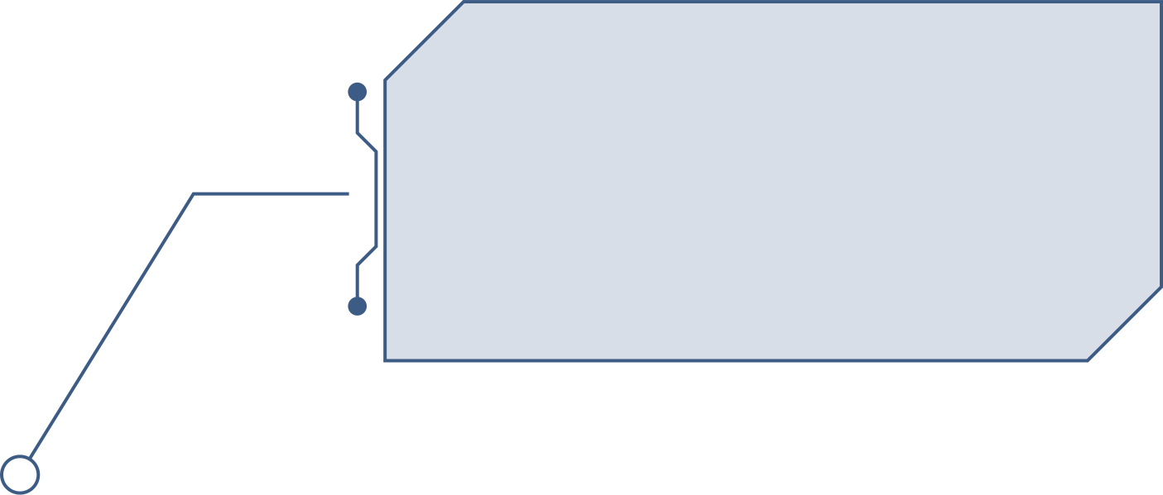
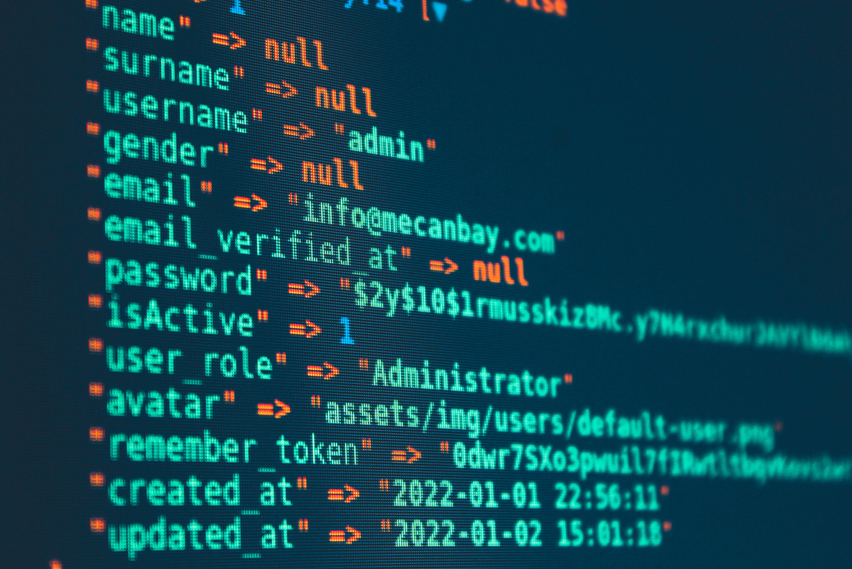




Red Team Goals
PAGE 6
1. Information Gathering
3. Exploitation
Identify open ports, services, OS info.
Use discovered vulnerabilities to gain access.
4. Post-Exploitation
2. Scanning
Maintain access, escalate privileges.
Use tools like nmap to map the attack surface
5. Documentation
Provide a professional report of findings.

Slide 7

PAGE 7
WITH THAT BEING SAID LET’S HEAD TO THE FIRST STAGE
Reconnaissance & Scan

Slide 8
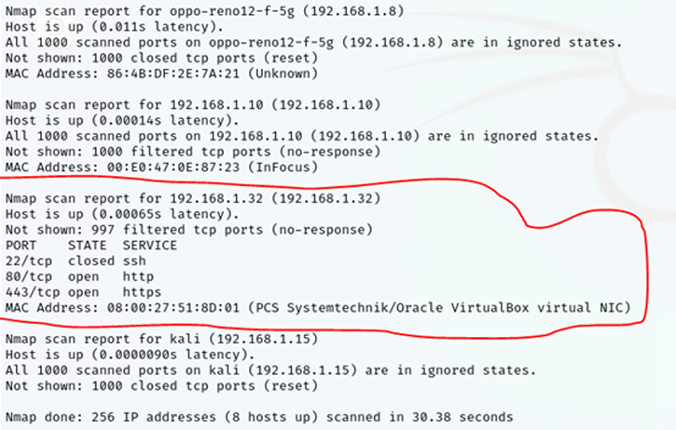
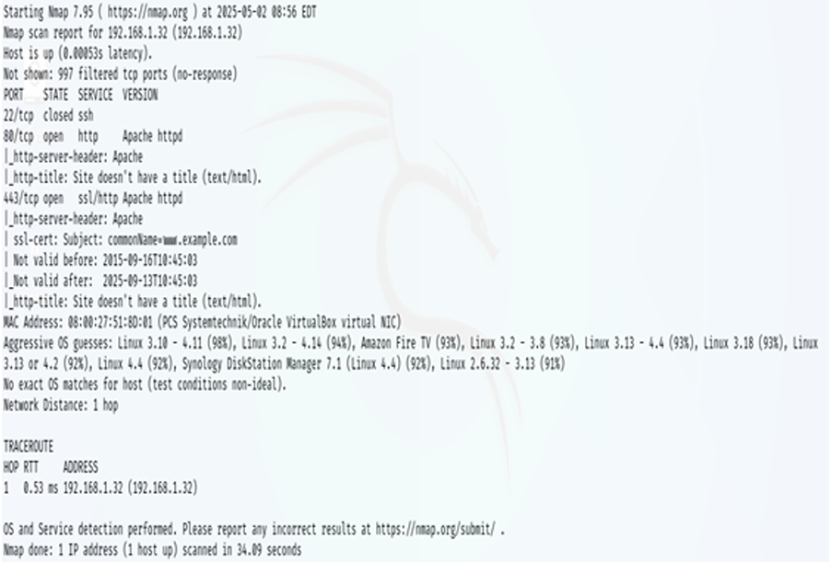
1-Scan &
Recon
PAGE 8
1-first sweep scanning to discover IP of target Machine by using nmap tool and the following command is nmap 192.168.1.32/24 and after searching between many devices online finaly I got machine with ip 192.168.1.32 With open ports 280,443
2-So that I would run the following command To scan the target machine and also To avoid any firewall and make stealth connection :
nmap -sS -Pn -T2 --scan-delay 1s --max-retries 1 -f -D RND:10 --source-port 53 192.168.1.32
the machine has open port 80 that means there is web site of machine So that we can get more info by using whatweb tool .

Slide 9
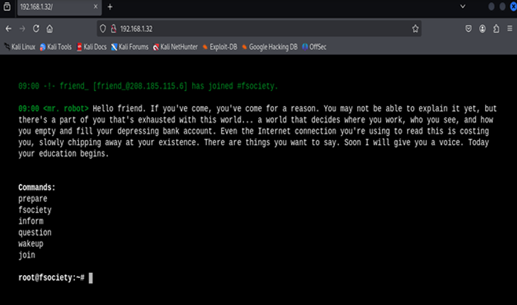
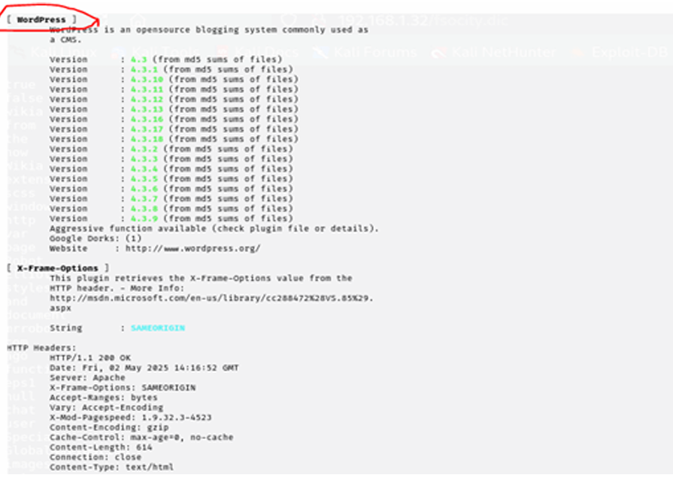
1-Scan &
Recon
PAGE 9
Note :WhatWeb is a web reconnaissance and vulnerability scanning tool that can identify various aspects of a website, including the web server, operating system, content management system (CMS)
I used the following command : Whatweb 192.168.1.32 -v -a 4 according of screens we would find many info like plugin of website is wordpress http server is apache
by the time opening of website in browser We had got screens it likes boot of machine called Mr robot without any interaction so that I will bruteforce to discover is there any open directory of website

Slide 10
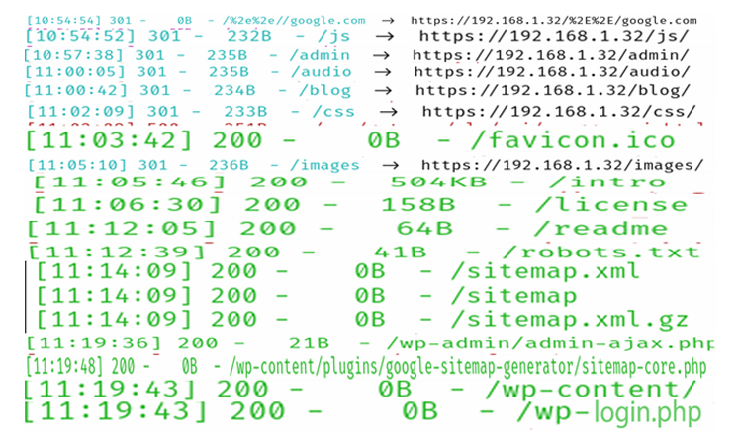
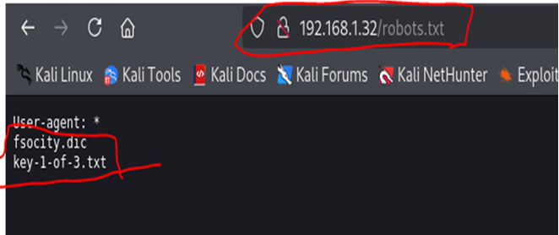
1-Scan &
Recon
PAGE 10
I would use dirsearch tool to search for any directory according of second screen we found many directories but most of them is forbidden and finaly I got
wp-login.php so that I would visit robots.txt
We found two directries
Fsocity.dic
Key-1-of-3.txt
After opening each one I found These Results
key-1-of-3.txt :Contains sensitive data .
Fsocity.dic: I got wordlist I guess it would help us to Bruteforce page of wp-login.php In next step .

Slide 11
PAGE 11
WITH THAT BEING SAID LET’S HEAD TO THE NEXT STAGE
BRUTE FORCE ATTACk

Slide 12
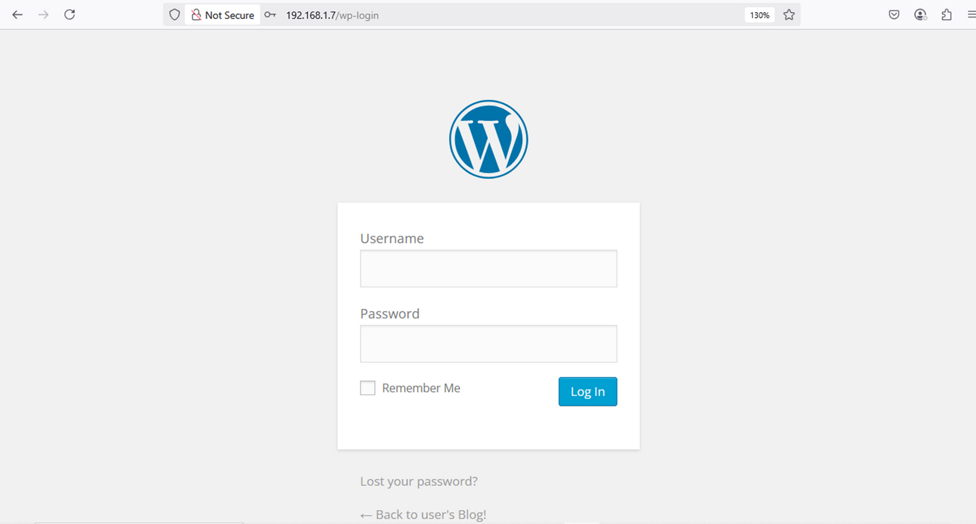
2-brute force
PAGE 12

Slide 13
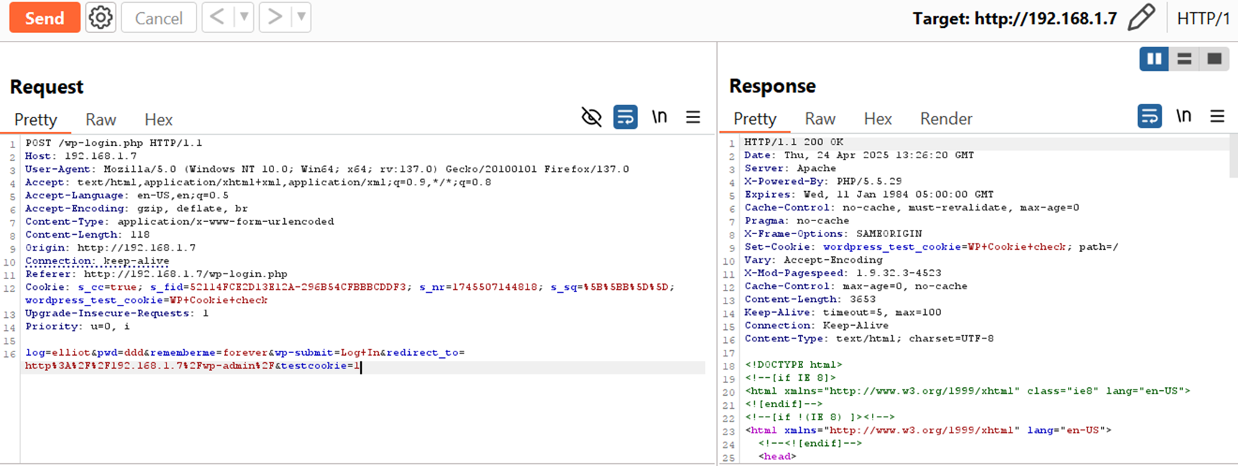
2-brute force
PAGE 13
No rate limit in request login

Slide 14
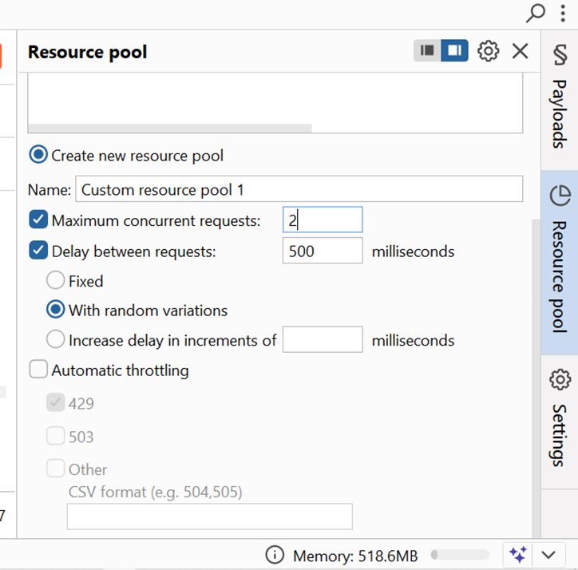
2-brute force
PAGE 14
TO bypass waf or firewall

Slide 15
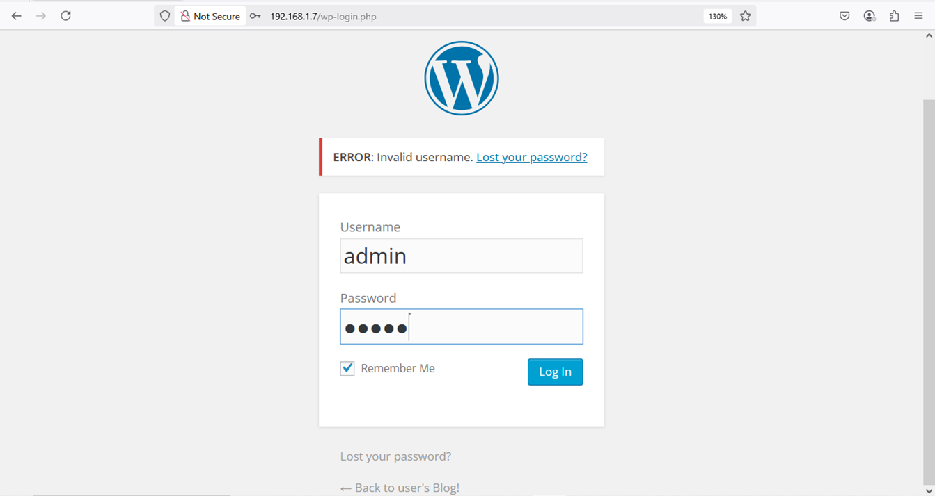
2-brute force
PAGE 15
Username enumeration when enter any user name output invalid user name

Slide 16
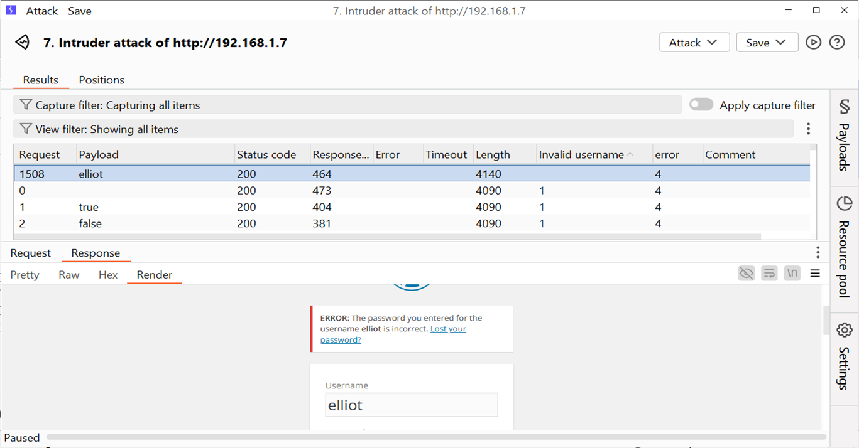
2-brute force
PAGE 16
Filter response by massage “Invalid username ”

Slide 17
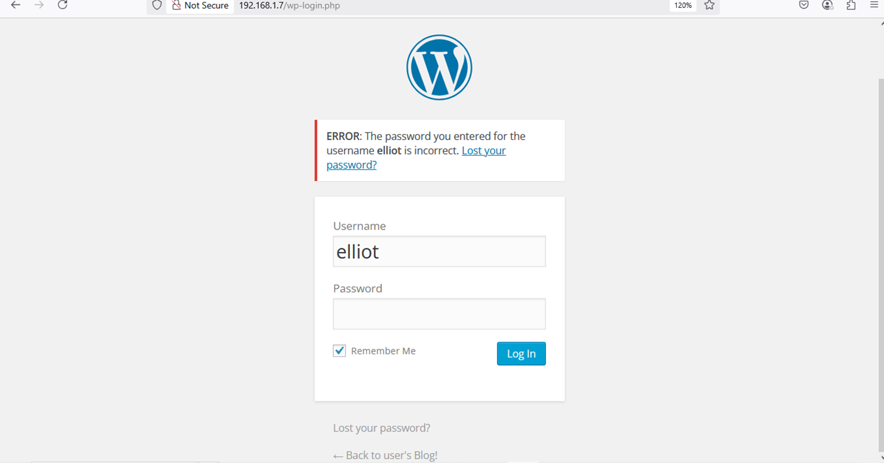
2-brute force
PAGE 17
When enter valid username output “the password you entered for the username Elliot incorrect ”

Slide 18
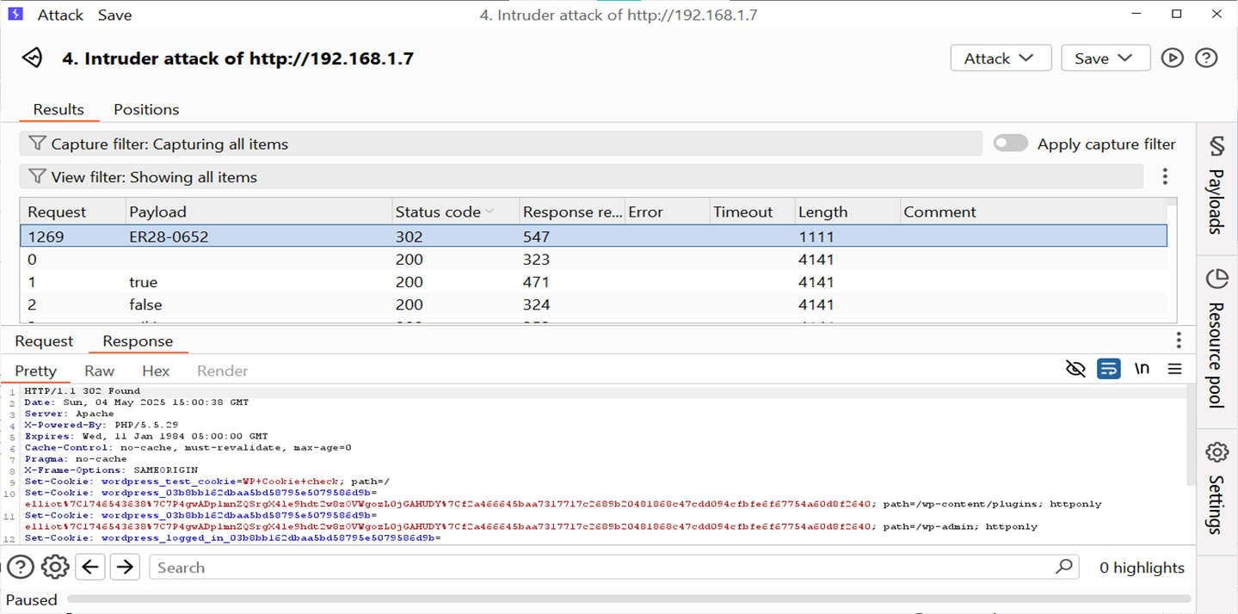
2-brute force
PAGE 18
When enter password valid status code 302

Slide 19
PAGE 19
WITH THAT BEING SAID LET’S HEAD TO THE NEXT STAGE
Reverse Shell

Slide 20
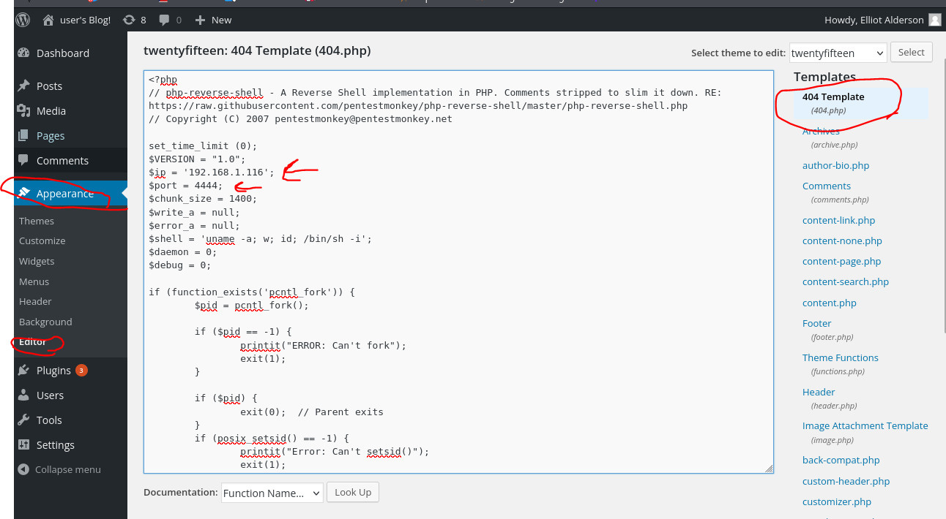
3-reverse shell
PAGE 20
we identify vulnerabilities such as file upload opportunities or Local/Remote File Inclusion (LFI/RFI). In this case, we also discovered a WordPress installation with a vulnerable plugin or misconfiguration that allows the upload or inclusion of a malicious PHP script.

Slide 21
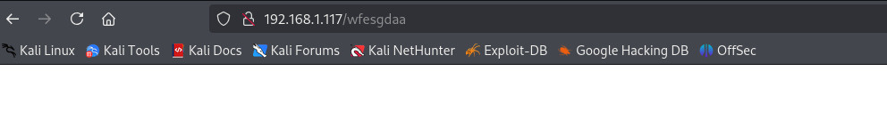
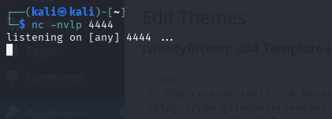
3-reverse shell
PAGE 21
we then host a malicious PHP reverse shell script on the target system, often by exploiting the identified vulnerability. On our machine as the attacker, a listener (e.g., using Netcat) is set up to receive the incoming connection. When the PHP script is executed on the target, it initiates a connection back to our listener, granting shell access to the victim machine.
triggering the 404 page to initiate the malicious php code

Slide 22
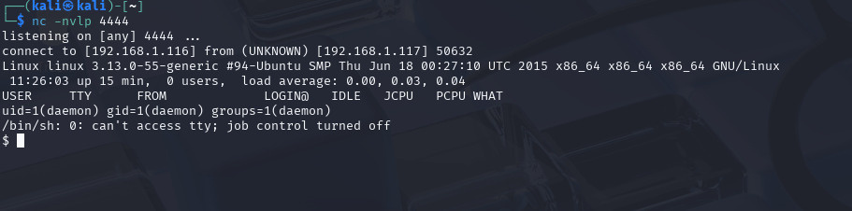
3-reverse shell
PAGE 22
successfully triggered the malicious php code and the initiated the reverse shell

Slide 23
PAGE 23
WITH THAT BEING SAID LET’S HEAD TO THE NEXT STAGE
md5 cracking

Slide 24
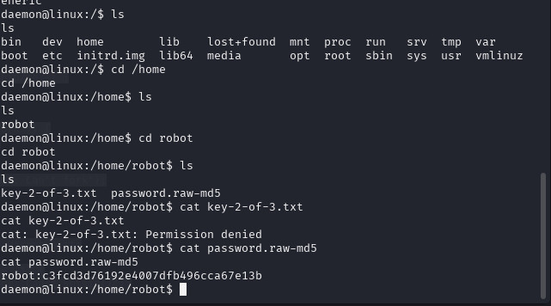
4-md5 cracking
PAGE 24
log into the system as the user daemon and begin exploring the /home directory. You find a robot user folder and attempt to access its contents.
However, you're denied permission when trying to read key-2-of-3.txt, indicating a restricted file.
There is a hash that maybe lead us to a password

Slide 25
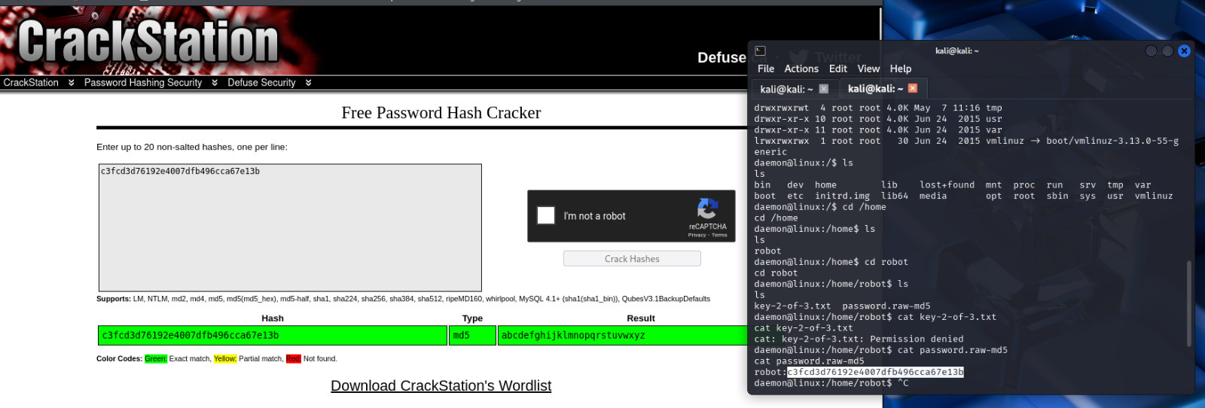
4-md5 cracking
PAGE 25
use the CrackStation website to crack the hash stored in password.raw-md5.
The hash c3fcd3d76192e4007dfb496cca67e13b is cracked successfully, revealing the password: abcdefghijklmnopqrstuvwxyz , which may lead us to the password of user robot

Slide 26
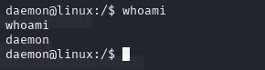
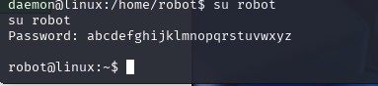
4-md5 cracking
PAGE 26
confirm current user identity by running whoami, which returns daemon.
This confirms I do not yet have sufficient permissions to access all files in the robot user directory.
You switch users using su robot and successfully authenticate with the password cracked from the MD5 hash.
Now logged in as robot, you gain full access to the protected files.

Slide 27
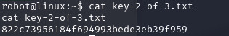
4-md5 cracking
PAGE 27
As the robot user, i can access and read the file key-2-of-3.txt, successfully retrieving the second key:
822c73956184f694993bede3eb39f959

Slide 28
PAGE 28
WITH THAT BEING SAID LET’S HEAD TO THE NEXT STAGE
privilege escalation

Slide 29
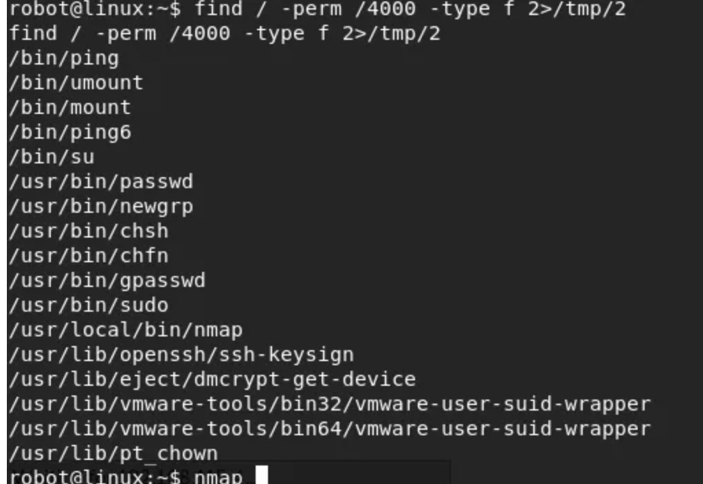
4-privilege escalation
PAGE 29
After gaining access to the system as the robot user, we realized that this level of access was insufficient to retrieve the third and final flag (key-3-of-3.txt), which is only accessible by the root user. Therefore, I needed to escalate my privileges to gain root-level access.
Privilege escalation can be achieved through various methods, but in this case, the successful approach was identifying a file or binary with the SUID (Set User ID) permission set. When a file has the SUID bit enabled, it runs with the privileges of the file’s owner—in many cases, root—regardless of which user executed it.
To find such files, I used the find command with the permission flag -perm -4000, which specifically searches for files that have the SUID bit set:
bash
Copy
Edit
find / -type f -perm -4000 -ls 2>/dev/null

Slide 30
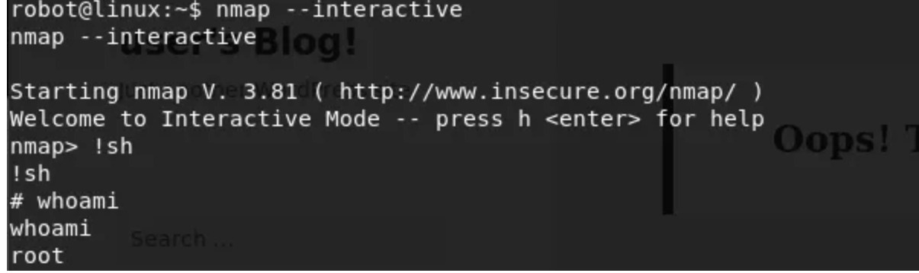
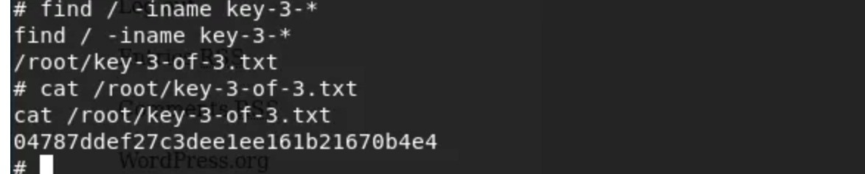
4-privilege escalation
PAGE 30
Older versions of nmap included an interactive mode feature that permitted users to execute shell commands directly from within the tool. Fortunately, the version installed on this machine still supports this functionality. By launching nmap in interactive mode, I was able to gain access to a command prompt. From there, I invoked a new shell using the !sh command. Upon verifying my user privileges with whoami, I confirmed that the shell was running with root permissions, successfully achieving privilege escalation.
To locate the third and final key, I searched the system for any file whose name begins with key-3-. Using the find command or simple shell navigation, I discovered that the file named key-3-of-3.txt is located within the /root directory—a location accessible only by the root user. After successfully escalating privileges, I accessed the directory and used the cat command to read the file’s contents. This revealed the third and final flag required to complete the challenge.

Slide 31
PAGE 31
WITH THAT BEING SAID LET’S HEAD TO THE NEXT STAGE
Covering
tracks

Slide 32
5-covering tracks
PAGE 32
Delete Command History
Clear shell command history with: history -c and unset HISTFILE
Also remove .bash_history, .zsh_history, etc.
Erase Uploaded Files:
Remove any tools/scripts uploaded for exploitation (e.g., reverse shells, scanners).
Remove Scheduled Tasks
Delete any malicious cron jobs: crontab -r
Check /etc/cron* and user crontabs.
Remove or Edit Logs
Delete or sanitize relevant log files:
/var/log/auth.log, /var/log/syslog, /var/log/apache2/access.log ,etc.
Use tools like logcleaner to automate this.
Or use sed to delete specific log entries by timestamp or IP.
Mask Your IP
Use proxies, VPNs, or TOR to avoid leaving real IP logs.

Slide 33
PAGE 33
WITH THAT BEING SAID LET’S HEAD TO THE LAST STAGE
defense strategies

Slide 34
PAGE 34
Web Application Hardening (WordPress)
Fix:
Always update WordPress core, plugins, and themes to the latest versions.
Remove unused plugins/themes.
Install a security plugin (like Wordfence) to detect common vulnerabilities.
defense strategies
Weak or Exposed Passwords/Hashes
Fix:
Never expose sensitive data (like passwords or hashes) in public directories, robots.txt, or comments.
Enforce strong password policies.
Store hashes using secure algorithms like bcrypt or Argon2 (not MD5 or SHA1).
Regularly rotate passwords and use two-factor authentication.

Slide 35
PAGE 35
Directory Enumeration/Information Disclosure
⟶ Vulnerability: Sensitive files and directories are accessible (/fsocity.dic, /key-1-of-3.txt)
⟶ Fix:
Disable directory listing in the web server config (Options -Indexes in Apache).
Use proper .htaccess rules to block access to sensitive files.
Do not leave backup files or wordlists in web directories.
defense strategies
Gaining Shell via WordPress (Remote Code Execution)
Fix:
Restrict file upload types.
Use least privilege: the web server user should not have write access to web root.
Disable PHP execution in upload directories (.htaccess or Nginx config).
Monitor for unexpected file changes or web shells.

Slide 36
PAGE 36
Privilege Escalation
Fix:
Audit system for SUID/SGID binaries (find / -perm -4000).
Remove or restrict permissions on unnecessary SUID files.
Use sudo carefully: grant only necessary permissions.
Keep the OS and packages updated to avoid kernel-level exploits.
defense strategies
General Hardening Measures
Set up a firewall to limit access to necessary ports.
Run services with minimum privileges.
Enable logging and monitoring (e.g., with Fail2Ban, auditd, or OSSEC).
Perform regular vulnerability scans.
Set up SELinux or AppArmor for added system hardening.

Slide 37
PAGE 37
We’re Almost Done

Slide 38
Team
PAGE 38
MAHMOUD MOSBAH
Team Leader
MOHAMED MAGDY
AHMED ALI
YOUSSEF RABIE
AYAH ELBAZ
MOHAMED MOHASEB
MAHMOUD GALAL

Slide 39
PAGE 39
Now we are done
Thank you for your listening

